Slide 1
Background :
We are looking for exciting ideas to create our new events hosting platform named “LowesForGeeks”.
“LowesForGeeks” is an unified portal which is aimed at our people and our organization itself where they can host events related but not limited to technology, hackathons, engineering events, organization wide events, townhalls, tech meet ups and team events.
Problem Statement: (** Please read this section carefully)
What we want from you is a MVP(Minimum Viable Product) solution for LowesForGeeks.
As part of the MVP we are expecting you to design a RESTful HTTP API based backend implementation to the solution.
**More details regarding this is explained in the “Requirements” section.
** Please Note:
This assignment is not a formal evaluation but a way for us to understand about your learning curve so far, analyze your utilization of the learning course and provide you with a better feedback on where you stand.
We do not expect a complete working solution to the problem. However, we are really interested to see your coding style, your object-oriented thinking, your attention to detail and your overall approach to designing the solution.
You are free to choose any IDE, programming languages, databases, open source libraries or frameworks you feel are right while developing your solution.
Bonus points if you use Java8+/Scala/Kotlin/Golang, Spring MVC, Spring Boot and a NoSQL based database (like MongoDB) in your solution.

Slide 2
Requirements (** Please read this section carefully)
Your solution must contain the following representations :
Event
Member
Team
Organization
Event :
An event should be of the following types :
Organization event
Includes organization wide events like campus drives, CSR initiatives, annual day events, social media events, public events involving our leadership.
Team event
Includes events across diverse teams like hackathons, townhalls, rewards and recognitions, technology workshops, team activities, sports competitions.
Private event
Includes private events like birthday celebrations, promotion ceremonies, employee parting ceremonies, fun events etc.
Some events can be recurring with recurring frequency being “daily(D), weekly(W), monthly(M) and yearly(Y).”
A daily recurring event starts and ends within the same day, a weekly recurring event starts and ends within the same week, a monthly recurring event starts and ends within the same month and a yearly recurring event starts and ends in the same year.

Slide 3
Requirements (contd.) (** Please read this section carefully)
Member :
A member should be of the following types with specified roles :
Organization admin
An organization admin can view and manage all organization events, team events and its own private events and cannot access other private events.
An organization admin can view and manage other organization admins, team admins and normal members.
An organization admin can view and manage the organization and all teams.
An organization admin can also be a team admin at the same time.
Team admin
A team admin can view and manage its own team events and its own private events but only view organization events, other team events and private events hosted by other members in the same team.
A team admin can view and manage other team admins in the same team and its other members.
A team admin can view and manage only its own team and its members but only view other teams and the organization.
A team admin can also be made an organization admin only if another organization admin chooses to do so.
Normal member
A normal member can view and manage its own private events but can only view team events, organization events and private
events hosted by other members in the same team.
A normal member can only view its own team, other teams, and the organization.
A normal member can only view team admins and organization admins.
A normal member can be made a team admin only if another team admin in the same team or an organization admin chooses to do so.
A normal member can be made an organization admin only if another organization admin chooses to do so.

Slide 4
Requirements (contd.) (** Please read this section carefully)
Team :
A team is comprised of a collection of members.
A team must have at least 1 team admin.
A member must be a part of at most 1 team at a time.
By default, the member who creates a team becomes the team admin.
Organization :
The organization is comprised of a collection of members.
There must be at least 1 organization admin.
By default, for your solution, you should create an organization admin at the start.
Member actions on events :
A member can like(and unlike) or watch(and un-watch) an event or both.
A member can register and update participation response to an event (Participating/May be participating/Not participating).
** For your better understanding, we have included basic class representation diagrams of each model (Event, Member, Team and Organization) below. **You are free to add and use any extra fields or classes in the representation, but your solution must contain all the fields shown in the class diagrams.

Slide 5
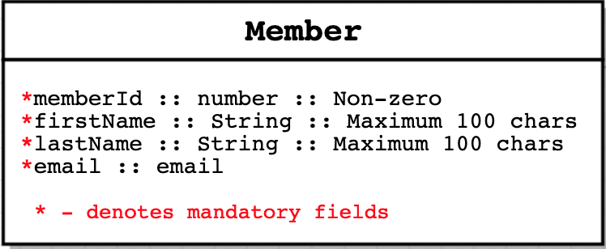
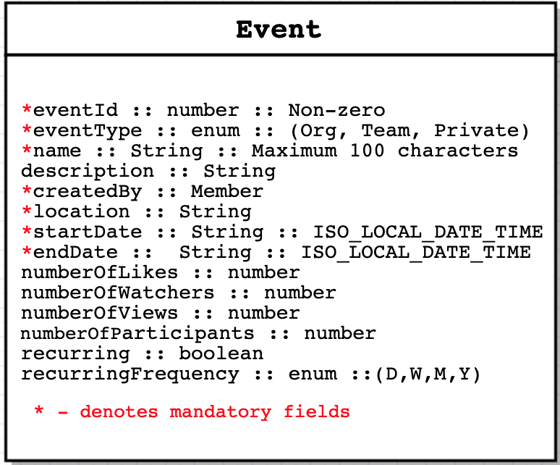
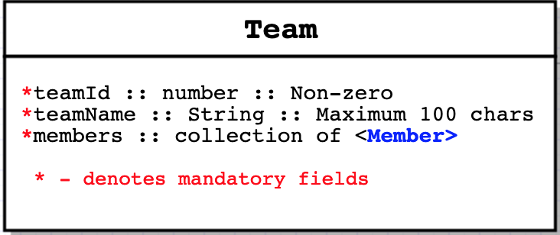
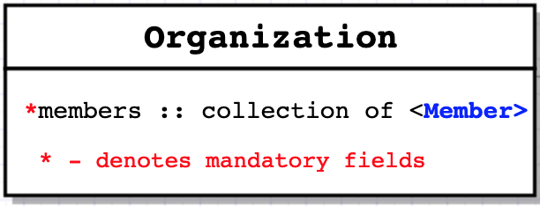
Requirements (contd.) (** Please read this section carefully)
Class diagrams :

Slide 6
Requirements (contd.) (** Please read this section carefully)
HTTP API requirements : Event APIs
Host a new event
This API is to enable a logged in member to host a new event based on the roles applicable to it.
An organization event must be created at a date at least 2 months prior to the event start date.
A team event must be created at a date at least 1 week prior to the event start date.
A private event must be created at a date at least 2 days prior to the event start date.
View an already hosted event
This API is to enable a logged in member to view an already hosted event based on the roles applicable to it.
Every time a member views an event, the “number of views” count gets increased by 1.
Update an already hosted event
This API is to enable a logged in member to update an already hosted event based on the roles applicable to it.
All events can only be postponed and never preponed.
Members can like(and unlike) or watch(and unwatch) an event or both.
Members can register and update their participation response to an event.
An organization event must be rescheduled at least 1 month prior to the original event start date.
A team event must be rescheduled at least 1 week prior to the original event start date.
A private event must be rescheduled at least 2 days prior to the original event start date.
Cancel an already hosted event
This API is to enable a logged in member to cancel an already hosted event based on the roles applicable to it.
An organization event must be cancelled at least 2 weeks prior to the event start date.
A team event must be cancelled at least 1 week prior to the event start date.
A private event must be cancelled at least 2 days prior to the event start date.
No event can be rescheduled or cancelled when it has already started.

Slide 7
Requirements (contd.) (** Please read this section carefully)
Event APIs
View Trending events
This API is to enable a logged member to view all trending events.
Trending events are either organization or team events which are created at least 2 months prior present time and starts at least 1 week after present time.
Trending events cannot be recurring events.
Your goal is to find such events sorted by the maximum total inclusive of number of likes, number of watchers and number of participants.
View Popular events
This API is to enable a logged in member to view all popular events.
Popular events are either organization or team events which are created at least 1 month prior present time and starts at least 2 days after present time.
Popular events can be recurring events.
Your goal is to find such events sorted by the maximum total inclusive of all number of likes and number of views.
View Upcoming events
This API is to enable a logged in member to view all upcoming events.
Upcoming events can be organization, team or private events which are created at most 1 week prior present time and starts at least
1 day after present time.
Upcoming events can be recurring events.
Your goal is to find such events sorted by the maximum number of views .
All non-recurring events are marked expired 5 mins after the event end date.

Slide 8
Requirements (contd.) (** Please read this section carefully)
Member APIs
Create a new member
This API allows a logged in member to create a new member based on the roles applicable to it.
View an existing member
This API allows a logged in member to view details of a member based on the roles applicable to it.
Update an existing member
This API is to enable a logged in member to update an existing member based on the roles applicable to it.
A member can be promoted to or demoted from a team admin and/or an organization admin.
Team APIs
Create a new team
This API is to enable a logged in member to create a new team based on the roles applicable to it.
View an existing team
This API is to enable a logged in member to view details of a team based on the roles applicable to it.
Update an existing team
This API is to enable a logged in member to update an existing team based on the roles applicable to it.
**You may design the APIs in any way you want but your APIs should meet RESTful standards and they must have the following structure :
All endpoints should be relative to the base path : http://<host>:<port>/lowesforgeeks (For e.g. : http://<host>:<port>/lowesforgeeks/events)
All requests should have a “loggedInMemberId” passed as a http request header.
All requests and responses must be represented in JSON format.

